Slide 1

The Health Behavior and
Health Promotion Concept
Lesson 1

Slide 2

DESCRIPTION
This chapter will determine : health promotion, the health behavior, and health behavior as an important determinant of health.

Slide 3

OBJECTIVES
General objective:
Students can explain the health promotion
concept and strategies
Specific objectives :
Students can explain The definition of health promotion, heath promotion strategies, target audience and scope of health promotion
Students can explain The definition of health behavior
Students can explain The health behavior as an important determinant of health.

Slide 4

What is HEALTH ?
Health is defined in the WHO constitution of 1948 as: a state of complete physical, social and mental well-being, and not merely the absence of disease or infirmity.
Within the context of health promotion, health has been considered less as an abstract state and more as a means to an end which can be expressed in functional terms as a resource which permits people to lead an individually, socially and economically productive life.
Health is a resource for everyday life, not the object of living. It is a positive concept emphasizing social and personal resources as well as physical capabilities.
(Ottawa Charter for Health Promotion. WHO, Geneva, 1986)

Slide 5
Global Causes of Death
Injuries
Communicable diseases, maternal and perinatal conditions, and nutritional deficiencies
Noncommunicable diseases
Source: WHO, World Health Report 2000—Health Systems: Improving Performance (Geneva: WHO, 2000).

Slide 6
Behavior change reduces risky behaviors

Slide 7
Ten Leading Risk Factors
for Preventable Disease
Maternal and child underweight
Unsafe sex
High blood pressure
Tobacco
Alcohol
Unsafe water, poor sanitation, and hygiene
High cholesterol
Indoor smoke from solid fuels
Iron deficiency
High body mass index or overweight
Source: WHO, World Health Report 2002: Reducing Risk, Promoting Healthy Life (Geneva: WHO, 2002), accessed online at www.who.int, on Nov. 15, 2004.

Slide 8

Health Promotion
Health promotion is the process of enabling people to increase control over, and to improve their health.
To reach a state of complete physical, mental and social well-being, an individual or group must be able to identify and to realize aspirations, to satisfy needs, and to change or cope with the environment.
(Ottawa Charter for Health Promotion. WHO, Geneva,1986)
Health promotion is the process of enabling people to increase control over the determinants
of health and thereby improve their health.
→ Participation is essential to sustain health promotion action.

Slide 9
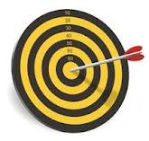
Health Promotion Strategies
Advocacy
Social Support
Empowerment
(WHO, 1994)

Slide 10
Health Promotion Strategies
Build Healthy Public Policy
Create Supportive Environments
Strengthen Community Actions
Develop Personal Skills
Reorient Health Services
(Ottawa Charter, 1986)

Slide 11

Health behaviour
Any activity undertaken by an individual, regardless of actual or perceived health status, for the purpose of promoting, protecting or maintaining health, whether or not such behavior is objectively effective towards that end.
Reference: Health Promotion Glossary, 1986

Slide 12
The Scope of Health Promotion based on the level of health services
Health Promotion at the level of promotion
Health Promotion at the level of preventive
Health Promotion at the level of curative
Health Promotion at the level of rehabilitative

Slide 13
Five level of Prevention :
(Leavel & Clark)
1
2
3
4
5
Health Promotion
Specific Protection
Early Diagnosis and Prompt Treatment
Disability Limitation
Rehabilitation

Slide 14
The Scope of Health Promotion
based on the places
1
2
3
4
5
Health promotion in the family (household)
School health promotion
Health promotion at the workplace
Health promotion in public places
Health education in health care institutions

Slide 15
Health Promotion Means Changing Behavior at Multiple Levels
A Individual: knowledge, attitudes, beliefs, personality
B Interpersonal: family, friends, peers
C Community: social networks, standards, norms
D Institutional: rules, policies, informal structures
E Public Policy: local policies related to healthy practices
Source: Adapted from National Cancer Institute, Theory at a Glance: A Guide for Health Promotion (2003), available online at http://cancer.gov.

Slide 16
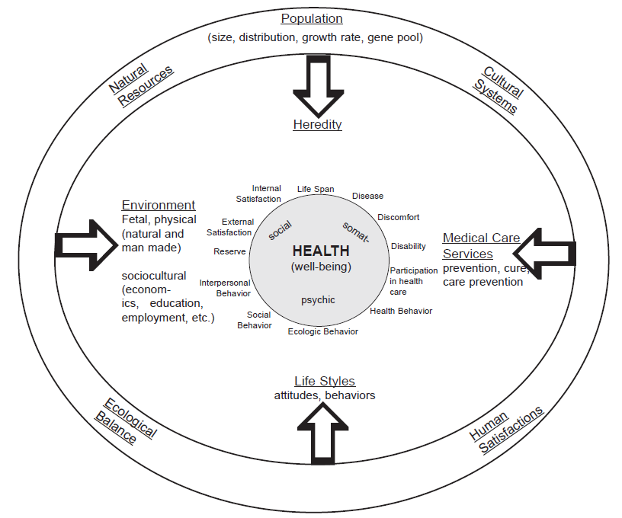
The Factors Influencing on Health
Behavior, including our lifestyle choices, have a greater effect
on our health than all other things combined.
Blum's "Force-Field and Well Being Paradigm of Health, 1984"

Slide 17
References
Notoatmodjo, Soekidjo. Promosi Kesehatan; Teori dan Praktek. PT Rineka Cipta. Jakarta. 2005
WHO, Ottawa Charter for Health Promotion First International Conference on Health Promotion Ottawa, 21 November 1986 - WHO/HPR/HEP/95.1
WHO, Health Promotion Glossary, WHO, Geneva, 1998
Peggy Hickman, A Systems Approach to Health Education, Rural Health Institute

Slide 18

C U next week !

